Slide 1
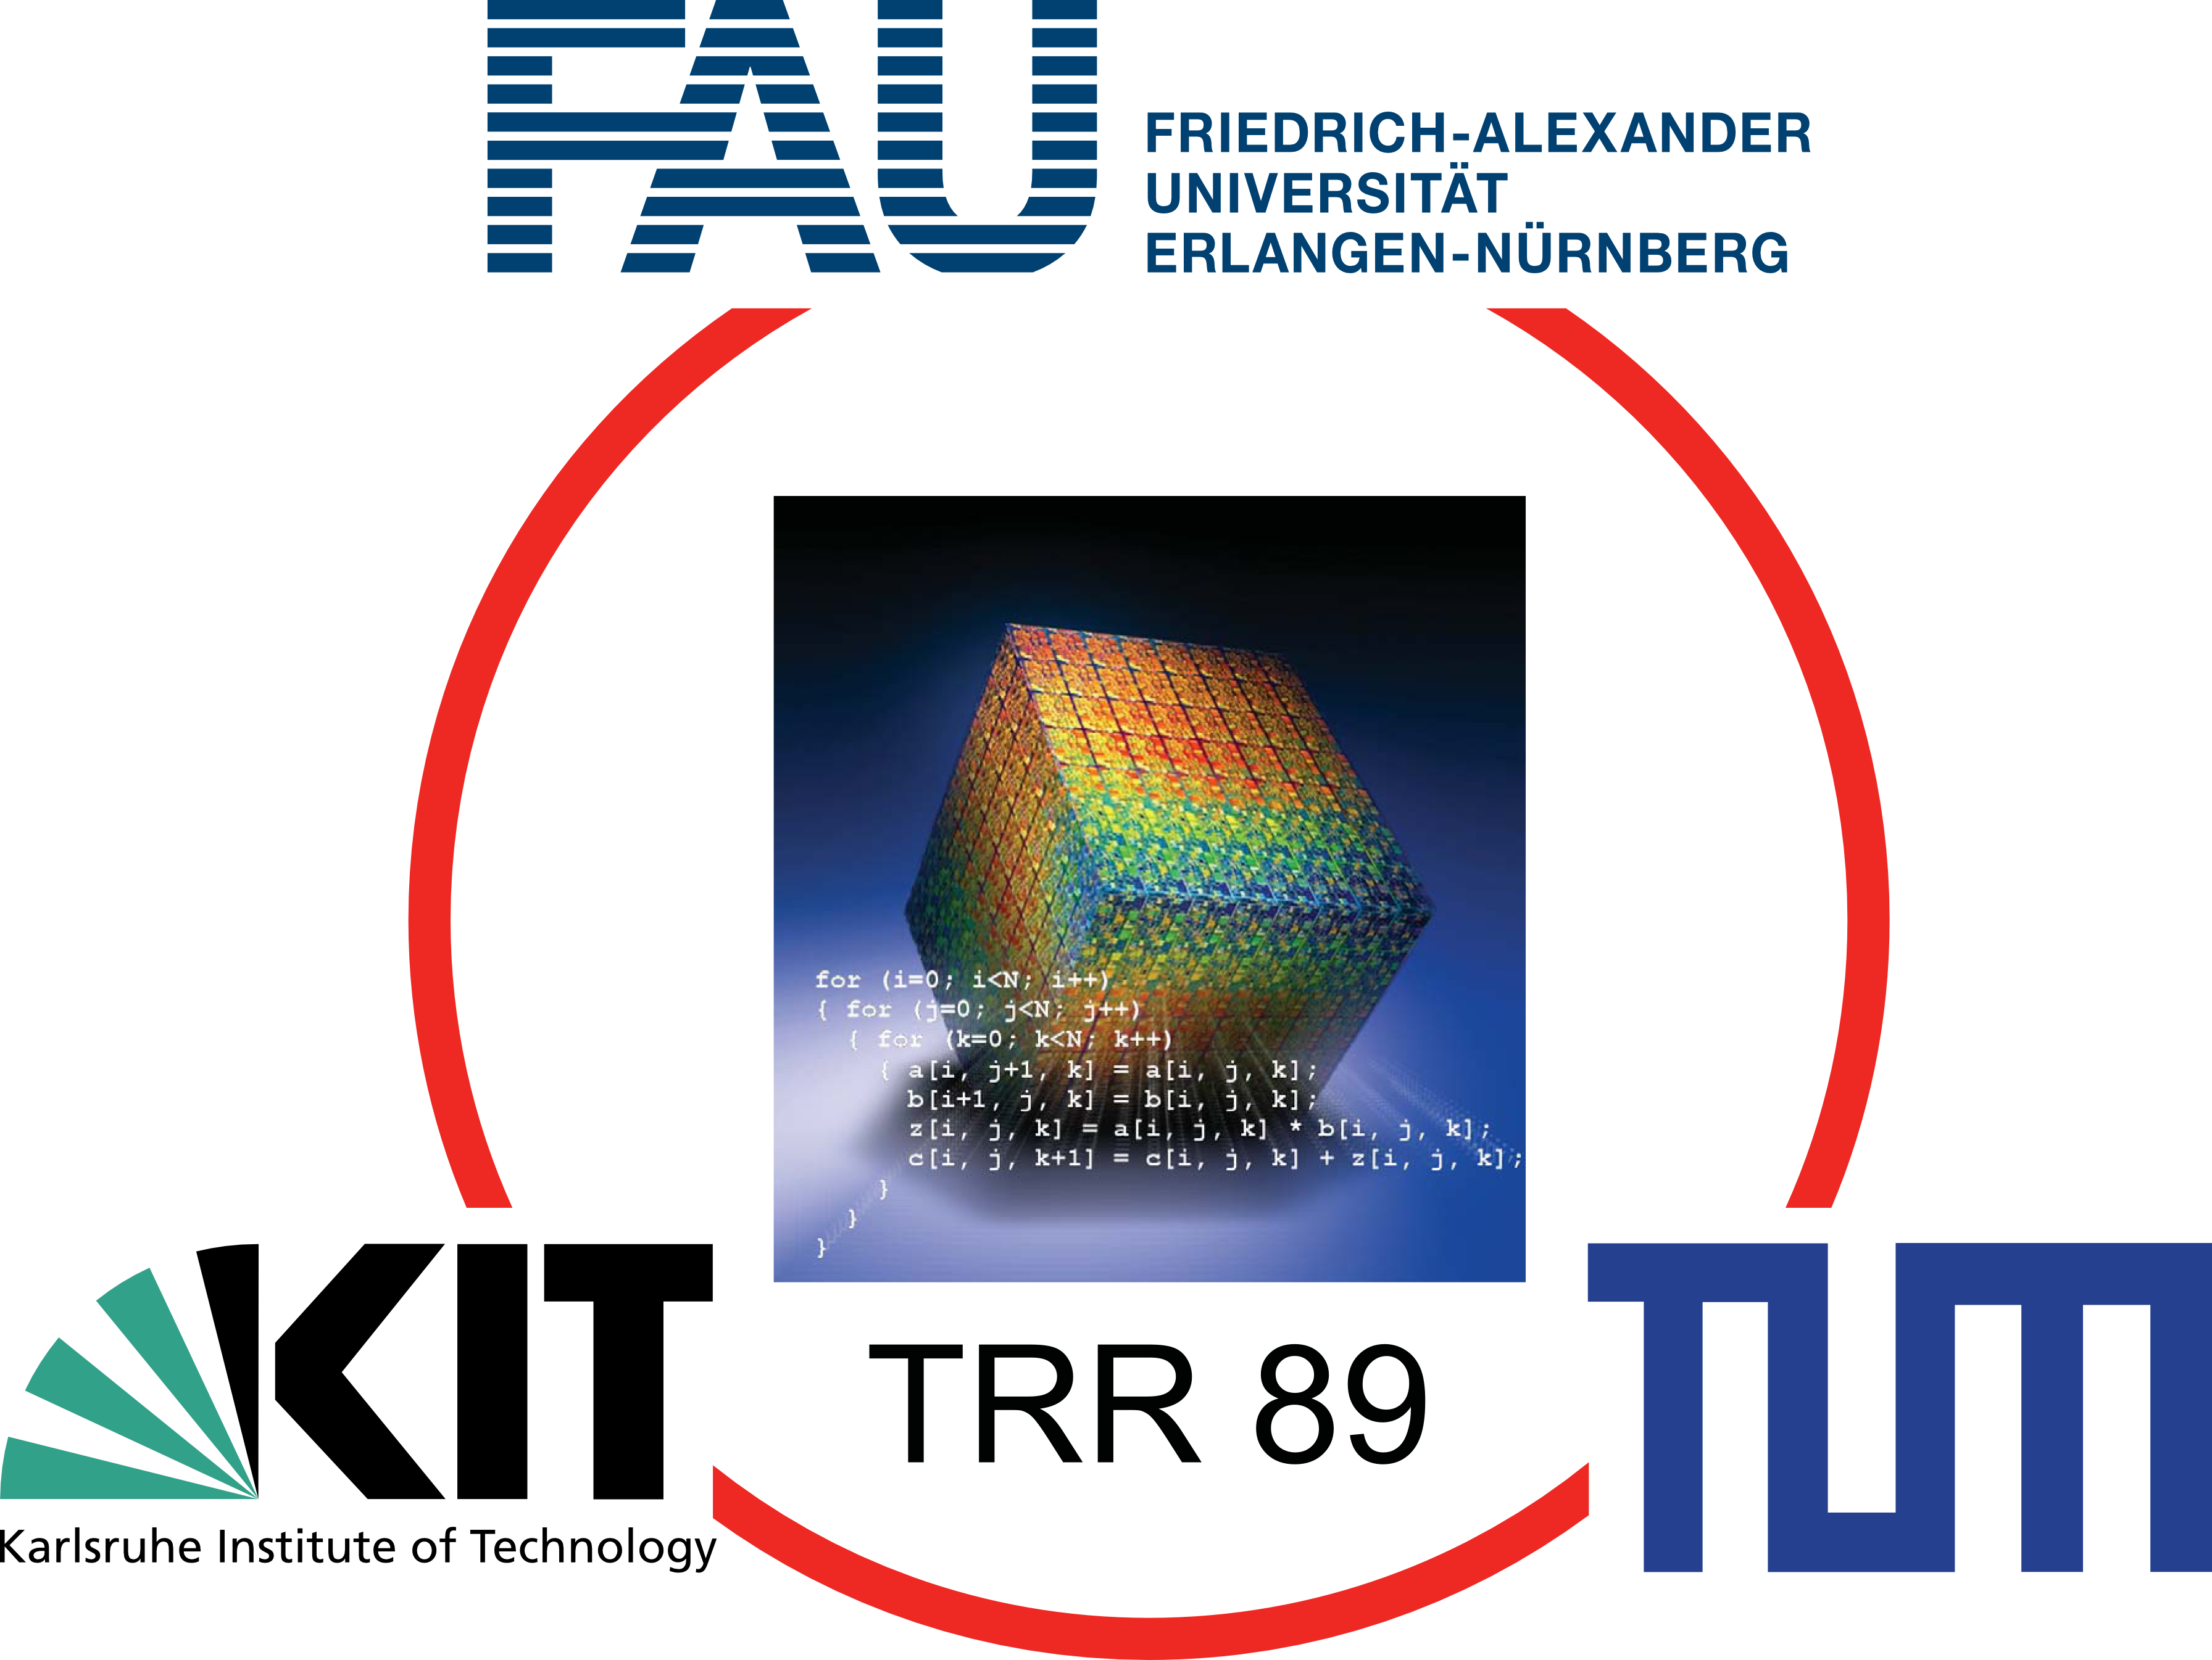

A UPC++ Actor Library and its Evaluation on a Shallow Water Application
Alexander Pöppl¹, Scott Baden², Michael Bader¹
¹Department of Informatics
Technical University of Munich
²Computational Research Division
Lawrence Berkeley National Laboratory
Department of Computer Science and Engineering
University of California, San Diego
Parallel Applications Workshop, Alternatives To MPI+X
November 18th 2019
Denver, Colorado

Slide 2
Motivation
Invasive Computing:
Dynamic resource allocation
Predictability through exclusive resource usage
Heterogeneous compute tiles
Actor-based Modelling
Good fit for architecture, enables exploration of different mappings of actors to compute tiles
SWE-X10 as sample application
Transfer to larger-scale applications
Is it feasible to program an actor library using standard languages and frameworks?
If so, how does performance compare, both to our X10-based library, and BSP?
Tools: C++, OpenMP, UPC++

Slide 3
UPC++
Asynchronous Partitioned Global Address Space (APGAS) Model
Reliance on one-sided communication
Asynchronous, continuation-based API
Based on GASNet-EX, makes direct use of InfiniBand and (some) Cray interconnects
Shared Segment
Shared Segment
…
Shared Segment
Private Segment
Private Segment
…
Private Segment
Rank 0
Rank 1
Rank n
Adapted from: UPC++ Specification v1.0 Draft 10, available at https://upcxx.lbl.gov

Slide 4


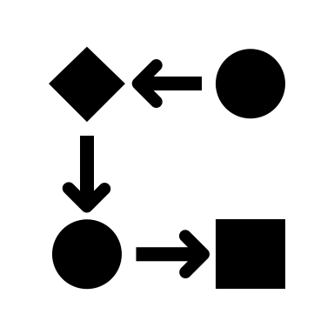




UPC++
RPCs
Executed asynchronously
Serialization and transfer of parameters, return value
Completion events available after the local part (or overall RPC execution) is finished
Global Pointers
Point to data in Shared segment
May be used as target for RMA operations
Distributed Objects
Created collectively
Same handle points to different objects on each rank
Rank m
…
Rank n

Slide 5
UPC++ Actor Library
Actors
Encapsulate specific functionality, data and behavior
Behavior defined through finite state machines
No data sharing between actors
Defined communication endpoints (Ports)
Have the ability compute whenever data in their ports (InPorts or OutPorts) changes
Actors are being triggered
Application Developers…
…subclass and implement act() method (actor FSM)
…use ports as communication endpoints
…specify which ports are connected

Slide 6
UPC++ Actor Library
Channels
Unidirectional connection between two ports
FiFo semantics
Operations: read(), write(T), peek()
Guards: available(), freeCapacity()

Slide 7
UPC++ Actor Library – Write
3:LPC
(track RPC
completion)
2:LPC
(trigger Actor)
A1
A2
A1::Out
A2::In
Channel
1:RPC
(insert Data)
Rank N
Rank M

Slide 8
UPC++ Actor Library – Read
4:LPC
(track RPC
completion)
2:RPC
(update capacity)
A1
A2
A1::Out
A2::In
Channel
1:read
(dequeue Data)
3:LPC
(trigger Actor)

Slide 9
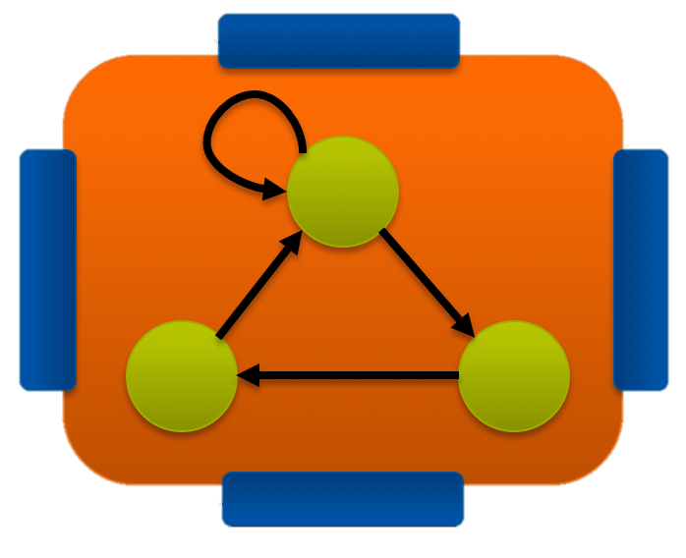
UPC++ Actor Library – Actor Execution Strategies
Rank-based Execution Strategy
One thread per UPC++ rank, one rank per (logical) core
One event loop:
Query runtime for progress
Execute RPCs, mark affected actors
Execute act() on affected actors
May use sequential UPC++ code mode
Low number of actors per rank
Query Runtime
Query Runtime
Query Runtime
Query Runtime
Perform RPCs
Perform RPCs
Perform RPCs
Perform RPCs
act()
act()
act()
act()

Slide 10
UPC++ Actor Library – Actor Execution Strategies
Task-based Execution Strategy
Map act() executions on OpenMP tasks
One event loop:
Master thread queries Runtime
Performs any incoming RPCs and triggers affected actors
Schedules OpenMP task for each invocation of act. Dependencies between act invocations of same actor
Large number of actors per rank possible
Master
Worker
Worker
Master
Worker
Worker
Query Runtime
act()
act()
Query Runtime
act()
act()
Perform RPCs
act()
act()
Perform RPCs
act()
act()
Schedule act()
act()
act()
Schedule act()
act()
act()

Slide 11
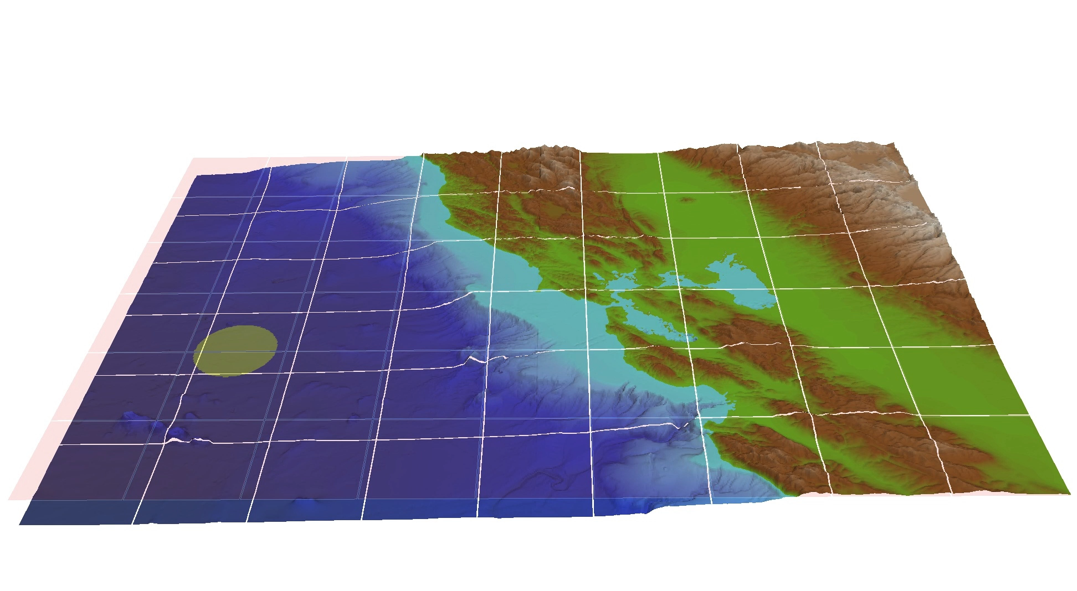
Pond – A Shallow Water Proxy Application
Based on prior applications
SWE, a BSP-based code written using MPI and OpenMP
SWE-X10, an actor-based X10 application written using the actorX10 library
Parallelized using our actor library
Possible to auto-vectorize with AVX512 with Intel Compiler (v18.0)

Slide 12
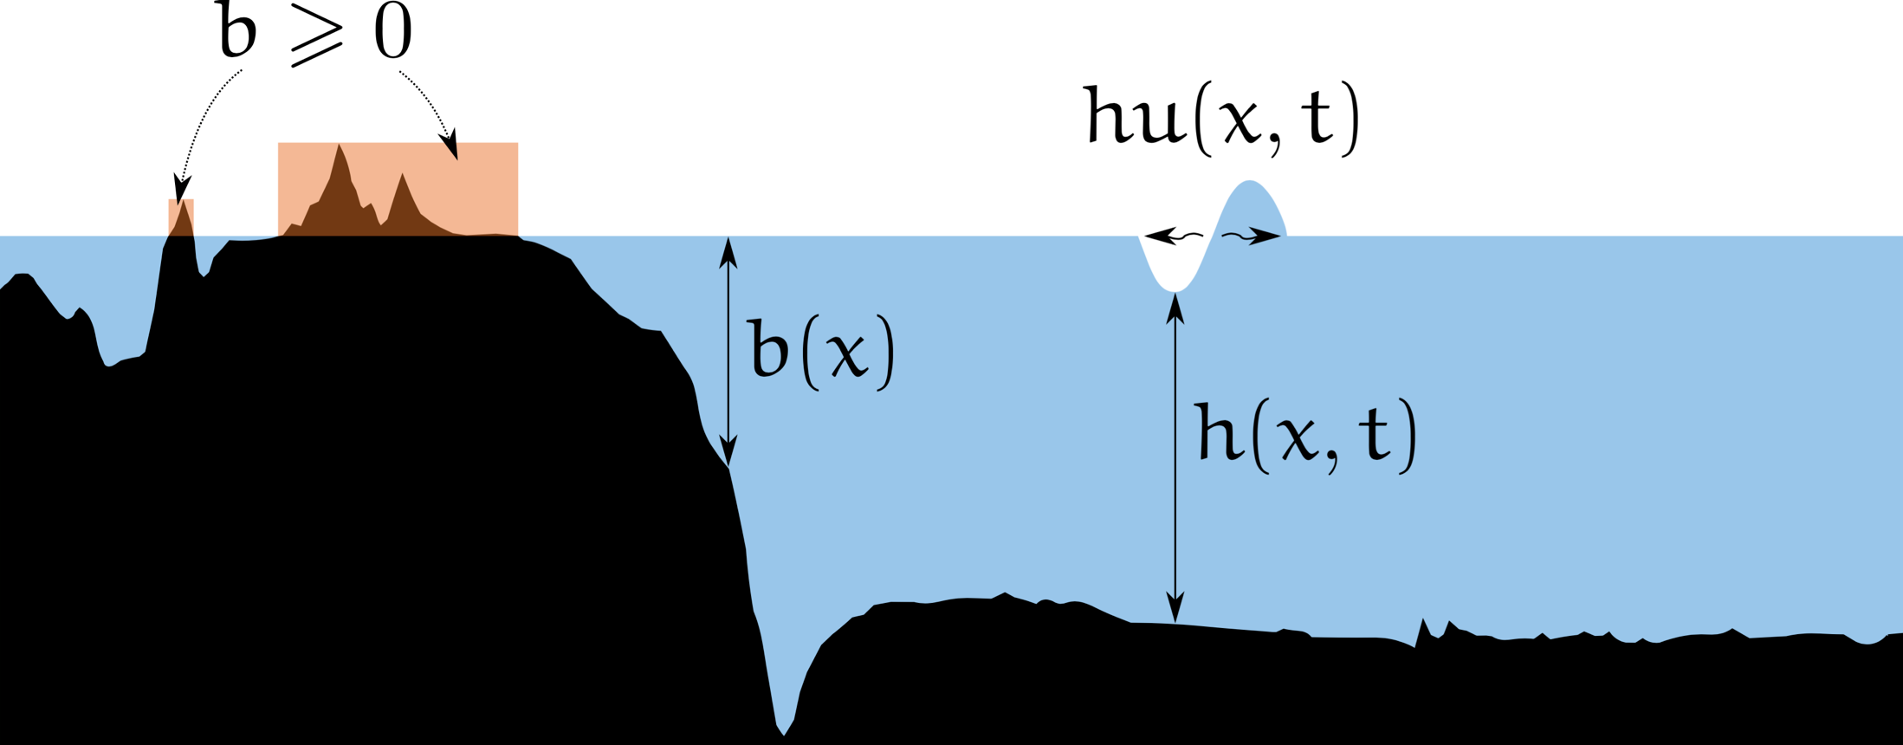
Pond – A Shallow Water Proxy Application
Image: Bachelor-Lab Tsunami Simulation
http://www5.in.tum.de/wiki/index.php/Tsunami_Simulation_-_Winter_15

Slide 13
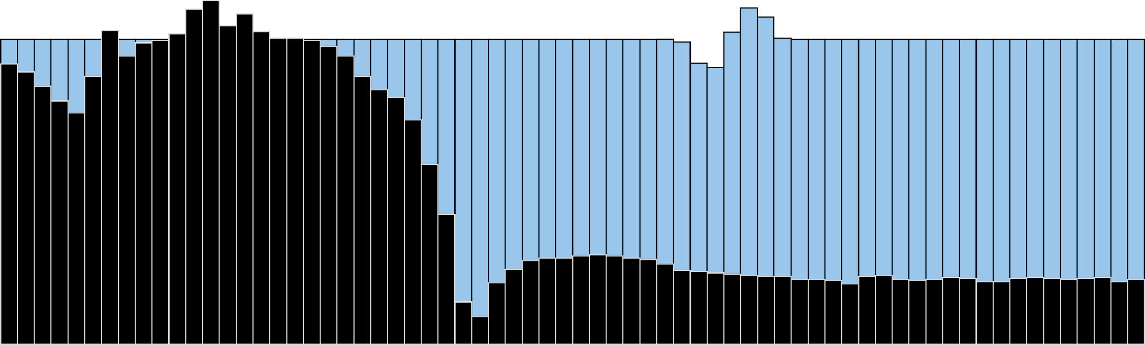
Pond – A Shallow Water Proxy Application
Finite volume scheme on a Cartesian grid with piecewise constant unknown quantities and Euler time step
Numerical approach based on LeVeque (R. J. LeVeque, D. L. George, and M. J. Berger. Tsunami modelling with adaptively refined finite volume methods. Acta Numerica, 20:211–289, 2011)
Image: Bachelor-Lab Tsunami Simulation
http://www5.in.tum.de/wiki/index.php/Tsunami_Simulation_-_Winter_15

Slide 14
Pond – A Shallow Water Proxy Application
Subdivision into rectangular, equally-sized patches with Halo regions

Slide 15
Pond – A Shallow Water Proxy Application
One actor per patch
Actors connected with direct neighbors

Slide 16

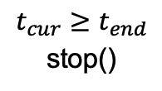
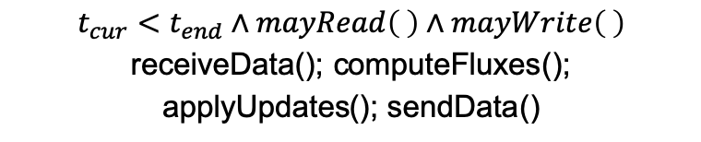
Pond – Simulation Actor
TopIn
TopOut
Done
$t_{cur}<$ $t_{end}∧mayRead\left( \right)∧mayWrite\left( \right)$
receiveData(); computeFluxes();
applyUpdates(); sendData()
LeftIn
RightIn
Init
compute
LeftOut
RightOut
$$mayWrite\left( \right)$$
sendData()
$t_{cur}≥$ $t_{end}$
stop()
BottomIn
BottomOut

Slide 17
Evaluation
Performed on NERSC Cori
Single socket Intel Xeon Phi (Knights Landing) nodes
68 cores (272 hyperthreads) per node
16GB MCDRAM
6TFlop/s (SP)
Intel Compiler 18, Vectorization using AVX512
Comparison of
SWE-X10, prior X10 application, based on actorX10, an X10 actor library
SWE, prior MPI+OpenMP application, follows the BSP model
Pond using our actor library (using the three available execution strategies, Rank, Thread and Task)
All subjects follow same numerical approach, same Riemann solver used in all cases

Slide 18
Evaluation – Weak Scaling
Radial Dam Break Scenario
4096² grid cells per node

Slide 19
Evaluation – Weak Scaling
Radial Dam Break Scenario
16384² grid cells per node
Patch sizes from 512x512 down to 64x64 grid cells

Slide 20
Conclusion
Competitive with OpenMP and MPI
UPC++ enables overlap of communication and computation
Higher abstraction level for application programmer
Flexibility regarding backend

Slide 21

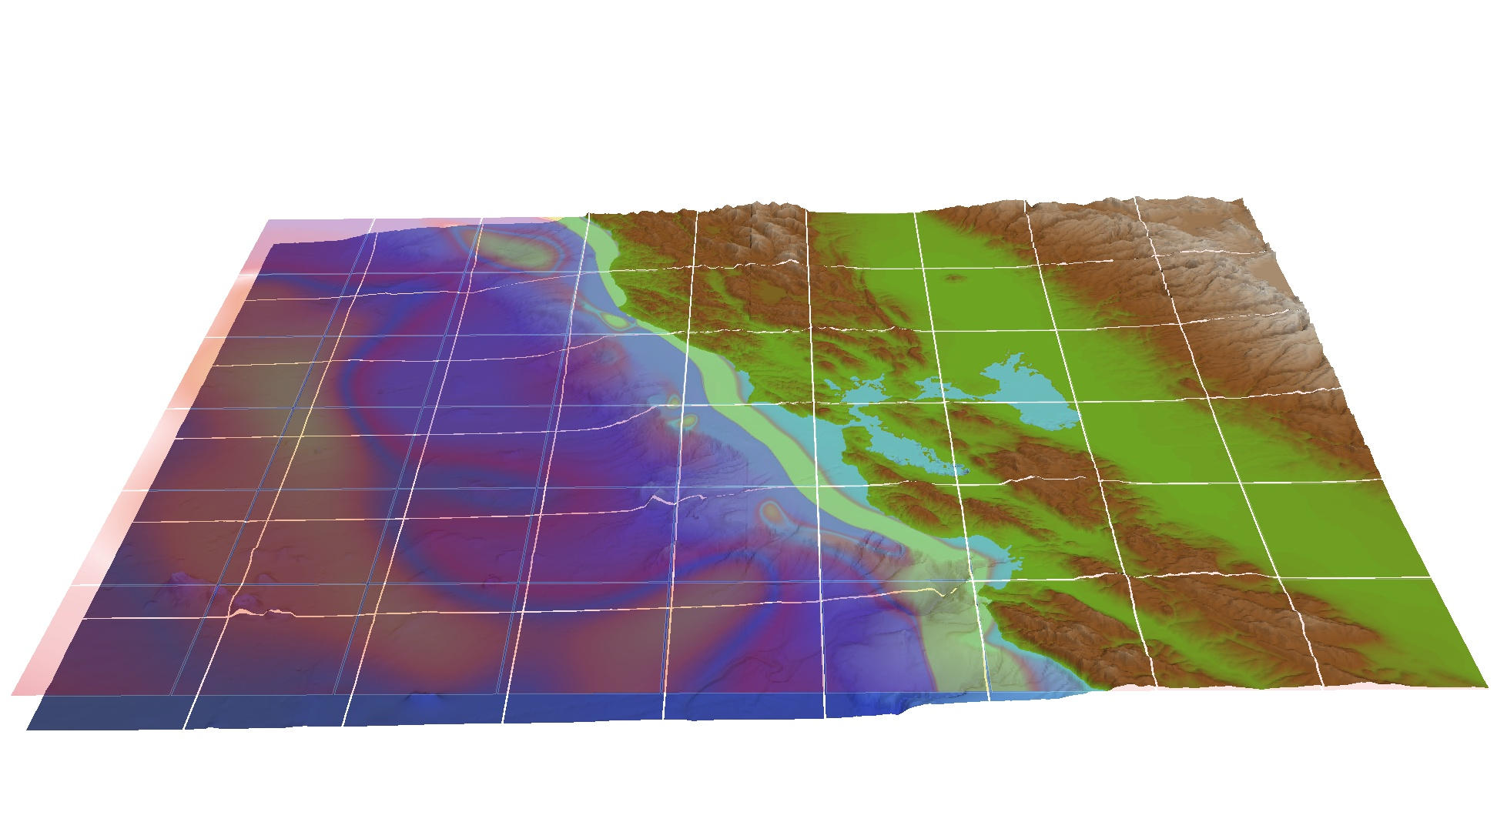
Questions + Acknowledgements
This research was funded by the German Research Foundation (DFG, Deutsche Forschungsgemeinschaft) - Project number 14671743 - TRR 89 Invasive Computing.
This research was supported by the Exascale Computing Project (17-SC- 20-SC), a collaborative effort of the U.S. Department of Energy Office of Science and the National Nuclear Security Administration.
This research used resources of the National Energy Research Scientific Computing Center, a DOE Office of Science User Facility supported by the Office of Science of the U.S. Department of Energy under Contract No. DE- AC02-05CH11231.
Scott Baden was supported in part by the Exascale Computing Project (17-SC-20-SC), a collaborative effort of the U.S. Department of Energy Office of Science and the National Nuclear Security Administration.
UPC++ Tutorial at LBL
December 16th
At NERSC or Online
More Info at: https://www.exascaleproject.org/event/upcpp
https://upcxx.lbl.gov ▶︎ News

Slide 22
UPC++ Actor Library – Actor Execution Strategies
Thread-based Execution Strategy
One thread per actor, and one communication thread, low number of ranks per node
Two event loops:
Communication thread queries runtime and executes RPCs
Actor threads query runtime for progress and execute LPCs, execute act
Requires balancing of communication thread against number of actors
Comm
Comm
Query Runtime
Query Runtime
Query Runtime
Query Runtime
Query Runtime
Query Runtime
Perform RPCs
Perform LPCs
Perform LPCs
Perform RPCs
Perform LPCs
Perform LPCs
act()
act()
act()
act()

Slide 23
Evaluation – Strong Scaling
Radial Dam Break Scenario
8192² grid cells per node
Patch sizes from 256x256 down to 32x32 grid cells

